Slide 1

Quantum Emulation Algorithm
FRONT DESK TEAM
Niraj Kumar
Mina Doosti
Andrea Husseiniova
Nuiok Dicaire
Pierre-Emmanuel Emeriau
Based on MARVIAN, Iman and Seth LlOYD, Universal Quantum Emulator, arXiv:1606.02734 (2016)
Notes:
Mina

Slide 2
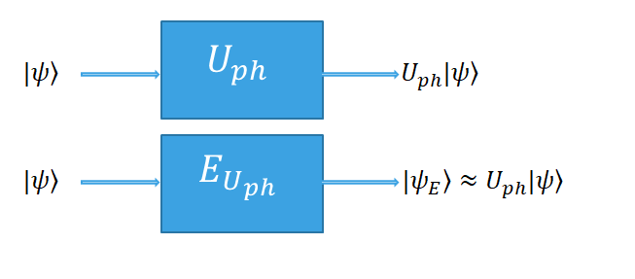


The problem
Motivations
Emulating the output of a linear transformation map on a quantum state, without having its explicit description, out of the sample data!
Unknown Unitary
Hardware Security
Learning a Quantum Process
Notes:
Mina

Slide 3
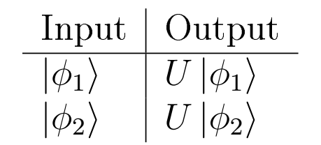
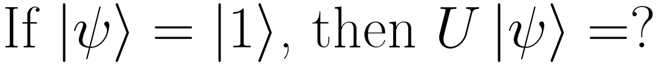
Identifying the Problem
Notes:
Nuiok

Slide 4
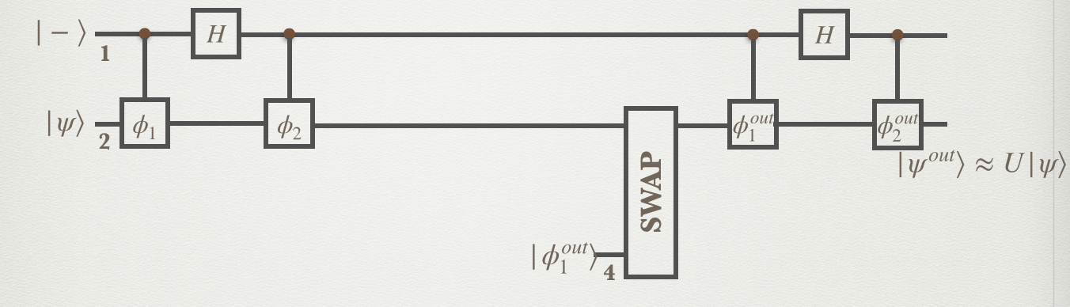
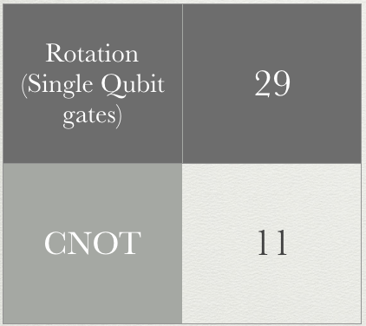
The Emulation Algorithm
MARVIAN, Iman and Seth LlOYD, Universal Quantum Emulator, arXiv:1606.02734 (2016)
Notes:
Niraj

Slide 5
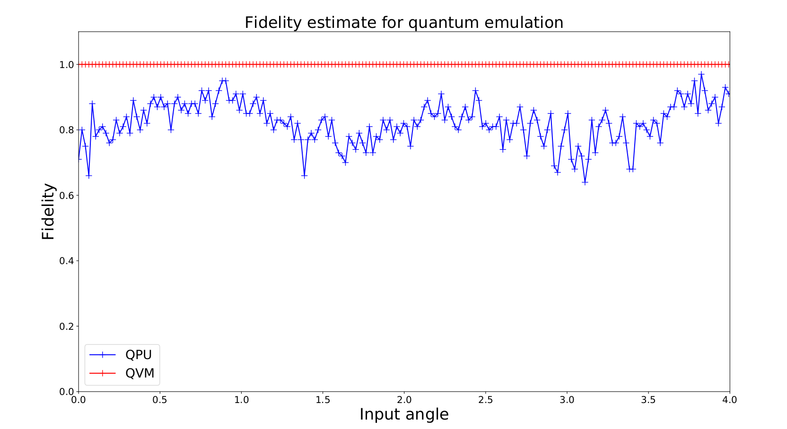
Results
Notes:
Pierre

Slide 6
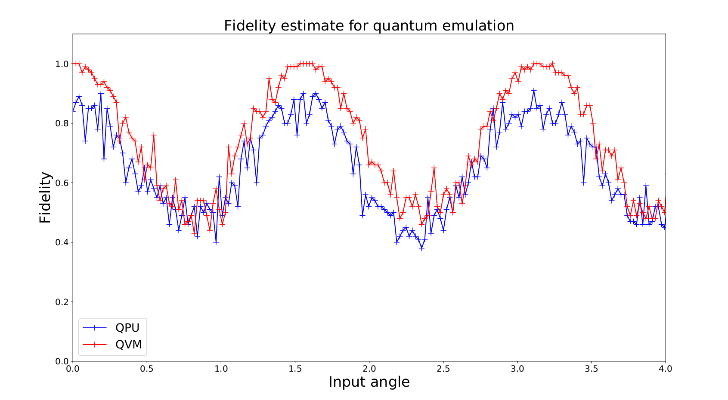
Results

Slide 7
Conclusions
Proof of concept:
Quantum emulation of an unknown unitary
Challenges:
Had to break up controlled reflection gates into PyQuil-provided gates
We learned:
Program and implement quantum circuits
Run parameterized programs on Quantum Processing Units (QPUs)
Notes:
Andrea
Break up reflection gate into gates provided in PyQuil

